Slide 1
Introduction to Robotics and Mechatronics
GROUP 2.5
Benson Chalethu
Pietro Griffa
Ingvar Groza
PostLab 03
Q1
The peak-to-peak amplitude of the generated signal is 2,40V.
Q2
The DC offset is 1,76V.
Q3
The frequency is 2,1 kHz.
Q4
To measure a point (a while loop step) it takes a time of 4,167us (=0,004167ms), which translate to an execution speed of 240 kHz.
Q5
The minimum is 0,560V and the maximum is about 3V. The voltage range is [0,56 3] and the voltage resolution is 2,4V/4096 = 0,5859 mV.

Slide 2
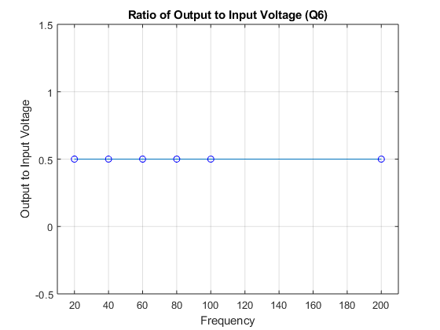
Q6
Frequency [Hz] | Peak-to-peak voltage [V]
20 | 1,2
40 | 1,2
60 | 1,2
80 | 1,2
100 | 1,2
200 | 1,2
As we expected by how we built the resistive divider circuit, the ratio of output to input voltage remains constant to 1,2V , not varying with the input frequency.
The delay is calculated with the following equation:
Where we consider the number of samples (120) and the execution time of the while loop (calculated in Q4).

Slide 3
Q7
Frequency [Hz] | Peak-to-peak [V] | Phase shift [°] | Phase shift [ms]
20 | 2,4 | 20 | 2,778
40 | 2,16 | 34 | 2,362
60 | 2 | 40 | 1,852
80 | 1,76 | 42 | 1,458
100 | 1,52 | 48 | 1,334
200 | 0,96 | 69 | 1,597
As we expected by how we built the resistive divider circuit, the ratio of output to input voltage remains costant to 1,2V , not varying with the input frequency.

Slide 4
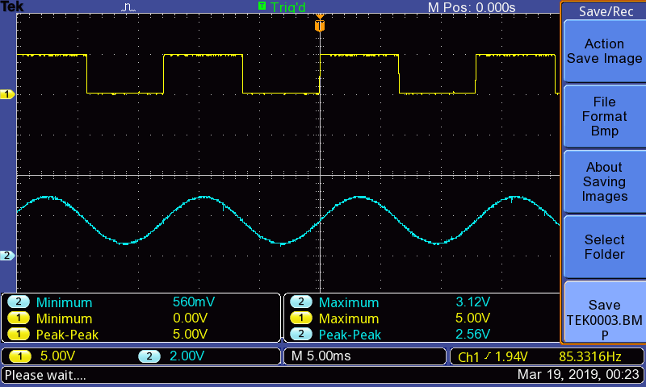
Q9
Q8
The DC offset is 1,76V.

